Slide 1
Lower Bounds: Circuit Complexity
Paul Beame
University of Washington

Slide 2
Boolean Circuits
$$∨$$
Each computes a function $f_{n}:\{0,1\}^{n}→\{0,1\}.$
Directed acyclic graph with nodes called gates
Input gates (in-degree 0)
each labeled by one of $x_{1},x_{2},…,x_{n}$
Computation gates, each labeled by a function of the values at its predecessor gates.
Often $∧\left(and\right), ∨\left(or\right), ¬ (not)$ (de Morgan basis)
fan-in = in-degree, typically 1 or 2.
One gate marked as output gate
Size = # of nodes,
Depth = length of longest input-to-output path
$$∧$$
$$∧$$
$$¬$$
$$¬$$
$$∨$$
$$∨$$
$$∧$$
$$∧$$
$$∧$$
$$∧$$
$$¬$$
$$¬$$
$$¬$$
$$¬$$
$$x_{1}$$
$$x_{2}$$
$$x_{3}$$
$$x_{4}$$
Size = 19 Depth=6

Slide 3
Boolean Circuits
$$∨$$
1
Each computes a function $f_{n}:\{0,1\}^{n}→\{0,1\}.$
$Size\left(f_{n}\right)=\min_{C computes f_{n}} Size(C)$
$Depth\left(f_{n}\right)=\min_{C computes f_{n}} Depth(C)$
Circuits for function family $f={\{f_{n}\}}_{n≥0}$, where $f_{n}:\{0,1\}^{n}→\{0,1\}$
“Non-uniform” model of computation, unlike TMs:
Devices for different input lengths may be unrelated.
$f$ computable in P ⇒ $Size\left(f_{n}\right)$ is $n^{O\left(1\right)}$
$$∧$$
1
0
$$∧$$
$$¬$$
$$¬$$
1
$$∨$$
0
1
$$∨$$
0
$$∧$$
0
1
$$∧$$
$$∧$$
0
0
$$∧$$
$$¬$$
$$¬$$
$$¬$$
$$¬$$
1
0
0
0
$$x_{1}$$
$$x_{2}$$
$$x_{3}$$
$$x_{4}$$
0
1
1
1
Complexity class P/poly

Slide 4
Limits of Boolean Circuits
Theorem (Shannon): All but a $o(1)$ fraction of Boolean functions require $Size\left(f_{n}\right)≥2^{n}/n−o(2^{n}/n)$
Proof: (Counting circuits of size $≤S$ vs functions)
Wlog $n$ fixed input gates plus $S≥n$ other gates
$S$ choices for output gate
Total $<S⋅{\left(3{\left(S+n\right)}^{2}\right)}^{S}=S^{O\left(S\right)}$ circuits
$2^{2^{n}}$ Boolean functions $f_{n}:\{0,1\}^{n}→\{0,1\}$.
For $S=o\left(2^{n}/n\right)$ we have $S\log{S=o(2^{n})}$ so only $2^{{o(2}^{n})}$ different functions.
Encoding a non-input gate:
3 label choices: $∧,∨,¬$
$<S+n$ choices for left predecessor
$<S+n$ choices for right predecessor
Total $3{\left(S+n\right)}^{2}$ choices
Sharper bound also true

Slide 5
Limits of Boolean Circuits
Theorem (Shannon): All but a $o(1)$ fraction of Boolean functions require $Size\left(f_{n}\right)≥2^{n}/n−o(2^{n}/n)$
Theorem (Lupanov): All Boolean functions have $Size\left(f_{n}\right)≤2^{n}/n$ $+ o(2^{n}/n)$
Hard explicitly-defined functions?
For arbitrary binary gates (including, e.g., $⊕$)
Best bound is $Size\left(f_{n}\right)≥3.1n−o(n)$ [Li-Yang 2022]
For de Morgan basis $∧,∨,¬$
Best bound is $Size\left(f_{n}\right)≥5n−o(n)$ [Iwama et.al. 2001]

Slide 6
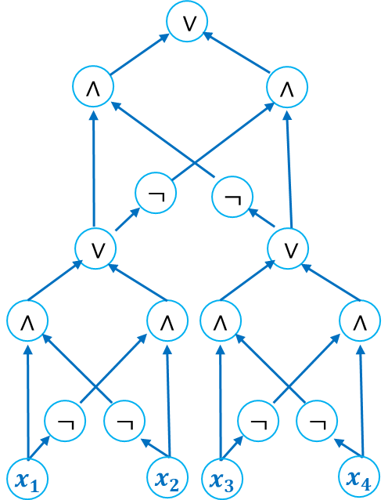
Boolean Formulas
Circuits where the directed acyclic graph is a tree
$$∨$$
Replicate nodes to make DAG a tree
$$∨$$
$$∧$$
$$∧$$
$$∧$$
$$∧$$
$$¬$$
$$¬$$
$$¬$$
$$¬$$
$$∨$$
$$∨$$
$$∨$$
$$∨$$
$$∧$$
$$∧$$
$$∧$$
$$∧$$
$$∧$$
$$∧$$
$$∧$$
$$∧$$
$$¬$$
$$¬$$
$$¬$$
$$¬$$
$$¬$$
$$¬$$
$$¬$$
$$¬$$
$$x_{1}$$
$$x_{2}$$
$$x_{3}$$
$$x_{4}$$
$$x_{1}$$
$$x_{2}$$
$$x_{1}$$
$$x_{2}$$
$$x_{3}$$
$$x_{4}$$
$$x_{3}$$
$$x_{4}$$

Slide 7
Boolean Formulas
Circuits where the directed acyclic graph is a tree
$$∨$$
Replicate nodes to make DAG a tree
$$∨$$
$$∧$$
$$∧$$
$$∧$$
$$∧$$
$$¬$$
$$¬$$
$$¬$$
$$¬$$
$$∨$$
$$∨$$
$$∨$$
$$∨$$
$$∨$$
$$∨$$
$$∧$$
$$∧$$
$$∧$$
$$∧$$
$$∧$$
$$∧$$
$$∧$$
$$∧$$
$$∧$$
$$∧$$
$$∧$$
$$∧$$
$$¬$$
$$¬$$
$$¬$$
$$¬$$
$$¬$$
$$¬$$
$$¬$$
$$¬$$
$$¬$$
$$¬$$
$$¬$$
$$¬$$
$$x_{1}$$
$$x_{2}$$
$$x_{1}$$
$$x_{2}$$
$$x_{3}$$
$$x_{4}$$
$$x_{3}$$
$$x_{4}$$
$$x_{1}$$
$$x_{2}$$
$$x_{1}$$
$$x_{2}$$
$$x_{3}$$
$$x_{4}$$
$$x_{3}$$
$$x_{4}$$
$$x_{1}$$
$$x_{2}$$
$$x_{1}$$
$$x_{2}$$
$$x_{3}$$
$$x_{4}$$
$$x_{3}$$
$$x_{4}$$
$$\left((x_{1}∧¬x_{2}\right)∨(¬x_{1}∨x_{2}))∧¬\left((x_{3}∧¬x_{4}\right)∨(¬x_{3}∨x_{4}))∨¬\left((x_{1}∧¬x_{2}\right)∨(¬x_{1}∨x_{2}))∧\left((x_{3}∧¬x_{4}\right)∨(¬x_{3}∨x_{4}))$$

Slide 8
Boolean Formulas
literals
$${\overline{x}}_{i}≡¬x_{i}$$
Conjunctive Normal Form (CNF)
$(x_{1}∨{\overline{x}}_{2}∨x_{3})(x_{2}∨x_{5}∨{\overline{x}}_{7})({\overline{x}}_{5}∨x_{7})({\overline{x}}_{3}∨x_{4}∨x_{6}∨x_{7})$
Disjunctive Normal Form (DNF) ${\overline{x}}_{1}x_{2}{\overline{x}}_{3} ∨ {\overline{x}}_{2}{\overline{x}}_{5}x_{7 }∨x_{5}{\overline{x}}_{7} ∨x_{3}{\overline{x}}_{4}{\overline{x}}_{6}{\overline{x}}_{7}$
clauses
Implicit $∧$ between clauses
terms
Implicit $∧$ between literals
k-CNF: clause size at most k
k-DNF: term size at most k
CNF-UNSAT= $\{CNF F : F≡0\}$
DNF-TAUT= $\{DNF F : F≡1\}$

Slide 9
CNF/DNF Formulas and Decision Trees
Decision trees start at root, query variables at nodes, follow out-edge based on value returned, output = value of leaf reached.
height = max # of vars queried on any path
$$x=1101$$
$$x_{1}$$
Decision tree complexity $D(f)$= min height of DT computing $f$
$$0$$
$$1$$
DNF
${\overline{x}}_{1}{\overline{x}}_{2}x_{4}∨{\overline{x}}_{1}x_{2}∨x_{1}{\overline{x}}_{3}x_{2}∨x_{1}x_{3}x_{4}$
$$x_{2}$$
$$x_{3}$$
$$0$$
$$1$$
$$0$$
$$1$$
CNF
$$\left(x_{1}∨x_{2}∨x_{3}\right)({\overline{x}}_{1}{∨x}_{3}∨x_{2})({\overline{x}}_{1}∨{\overline{x}}_{3}∨x_{4})$$
$$x_{4}$$
1
$$x_{2}$$
$$x_{4}$$
$$0$$
$$1$$
$$0$$
$$1$$
$$0$$
$$1$$
Clause/term size at most $D(f)$
0
1
0
1
0
1

Slide 10
Decision Tree for $Parity(x1, x2, x3, x4)$
$$x_{1}$$
$$0$$
$$1$$
$$x_{2}$$
$$x_{2}$$
$$0$$
$$1$$
$$0$$
$$1$$
$$x_{3}$$
$$x_{3}$$
$$x_{3}$$
$$x_{3}$$
$$0$$
$$1$$
$$0$$
$$1$$
$$0$$
$$1$$
$$0$$
$$1$$
$$x_{4}$$
$$x_{4}$$
$$x_{4}$$
$$x_{4}$$
$$x_{4}$$
$$x_{4}$$
$$x_{4}$$
$$x_{4}$$
$$0$$
$$1$$
$$0$$
$$1$$
$$0$$
$$1$$
$$0$$
$$1$$
$$0$$
$$1$$
$$0$$
$$1$$
$$0$$
$$1$$
$$0$$
$$1$$
0
1
1
0
1
0
0
1
1
0
0
1
0
1
1
0

Slide 11
Limits of Boolean Formulas
Lemma (Shannon): There are only $n^{O\left(S\right)}$ distinct formulas on $n$ bits of size at most $S$.
Proof: Wlog only binary gates and inputs are from $x_{1},…,x_{n},{\overline{x}}_{1},…,{\overline{x}}_{n}$.
Only $4^{S}$ binary trees with $S$leaves, ${\left(2n\right)}^{S}$ ways of labelling leaves, ${≤16}^{S−1}$ choices for other gates.
Formula size of almost all Boolean functions on $n$ bits is $Ω(2^{n}/\log{n)}$

Slide 12
Limits of Boolean Formulas
Element Distinctness:
$ED_{n}\left(x_{1},…,x_{2^{k}}\right)=1$ iff all $x_{i}≠x_{j}$ : each $x_{i}$ is $2k$ bits long and $n=2^{k+1}k$.
Theorem (Nechiporuk): Any formula $F$computing $ED_{n}$ requires size $Ω(n^{2}/\log{n)}$.
Proof idea: Restrictions and subfunctions.

Slide 13
Limits of Boolean Formulas
Defn: Restriction (partial assignment) ${ρ∈\left\{0,1,∗\right\}}^{n}$ sets all bits but $x_{i}$ for $i∈ρ^{−1}\left(∗\right)$.
For circuit $F$ computing Boolean function $f$, restricted circuit $F{\left.​\right|}_{ρ}$ computes function $f{\left.​\right|}_{ρ}$ on unset bits $x_{i}$ (plug in 0,1-values and simplify).
Lemma: For formula $F$ computing $f$ and subset of variables $A$ with $≤L$ leaves labeled by vars in $A$ there are ${≤2}^{O\left(L\right)}$ different “subfunctions” $f{\left.​\right|}_{ρ}$ over all $ρ$ with $ρ^{−1}\left(∗\right)=A.$
Proof: Induction on subformulas.
(Throw in constant functions and complements for free to handle case that one side has 0 leaves from $A$.)
binary gate
#
G
H
$ℓ$ leaves from $A$
$≤c^{ℓ}$ subfunctions*
$k$ leaves from $A$
$≤c^{k}$ subfunctions*
Total: $≤c^{k}c^{ℓ}=c^{k+ℓ}$ subfunctions
*depending on how other bits are set

Slide 14
Limits of Boolean Formulas
$ED_{n}\left(x_{1},…,x_{2^{k}}\right)=1$ iff all $x_{i}≠x_{j}$ : each $x_{i}$ is $2k$ bits long and $n=2^{k+1}k$.
Theorem (Nechiporuk): Any formula $F$computing $ED_{n}$ requires size $Ω(n^{2}/\log{n)}$.
Lemma: For formula $F$ computing $f$ and subset of variables $A$ with $≤L$ leaves labeled by vars in $A$ there are ${≤2}^{O\left(L\right)}$ different “subfunctions” $f{\left.​\right|}_{ρ}$ over all $ρ$ with $ρ^{−1}\left(∗\right)=A.$
Proof of Nechiporuk’s Theorem:
Basic idea: For Boolean formulas, size ≈ # of leaves.
Each leaf is labelled by exactly one bit.
For each of the $2^{k}\text{≈} n/ log n$ disjoint blocks $x_{i}$ (which has $2k$ bits) apply lemma with $A=$ bits of $x_{i}$ to argue $Ω(n)$ leaves labelled by bits of $x_{i}$.

Slide 15
Limits of Boolean Formulas
$ED_{n}\left(x_{1},…,x_{2^{k}}\right)=1$ iff all $x_{i}≠x_{j}$ : each $x_{i}$ is $2k$ bits long and $n=2^{k+1}k$.
Theorem (Nechiporuk): Any formula $F$computing $ED_{n}$ requires size $Ω(n^{2}/\log{n)}$.
Lemma: For formula $F$ computing $f$ and subset of variables $A$ with $≤L$ leaves labeled by vars in $A$ there are ${≤2}^{O\left(L\right)}$ different “subfunctions” $f{\left.​\right|}_{ρ}$ over all $ρ$ with $ρ^{−1}\left(∗\right)=A.$
Proof of Nechiporuk’s Theorem:
At least $\left(\begin{matrix}2^{2k} \\ 2^{k}−1\end{matrix}\right)=2^{Ω\left(k2^{k}\right)}=2^{Ω\left(n\right)}$ different subfunctions $ED_{n}{\left.​\right|}_{ρ}$ possible on bits of $x_{i}$
(Different subfunctions on $x_{i}$ for each choice of distinct values of other $2^{k}−1$ inputs)
Lemma ⇒ $F$ has $Ω(n)$ leaves labeled by bits of $x_{i}$ for each of $2^{k}=n/(2\log{n)}$ choices of $i.$

Slide 16
Limits of Boolean Formulas
For de Morgan basis, only slightly better lower bounds:
Theorem (Krapchenko): Parity on $n$ bits requires $∧,∨,¬$formula size $Ω\left(n^{2}\right)$. bound is tight
Theorem (Andreev, Håstad, Tal): An explicit $n$-bit function requires $∧,∨,¬$formula size $Ω\left(n^{3}/\log^{1+o(1)}{n}\right)$
Andreev function uses $log⁡n$ parities on $n/log⁡n$ bits to index into $n$-bit table of values. (bound is nearly tight)
Proof Based on how random restrictions shrink $∧,∨,¬$formulas plus counting of # of distinct formulas of given size and fact that parity doesn’t change much under restriction.

Slide 17
Monotone Circuits

Slide 18
Monotone functions and monotone circuits
Defn: A function $f$ is monotone iff flipping input bit from $0$ to $1$ cannot flip $f$ from $1$ to $0$
Monotone circuits: Circuits over connectives $∧, ∨$
Only compute monotone functions

Slide 19
Monotone Size Lower Bounds
Theorem: [Razborov 1985, Alon-Boppana 1987] ${Size}_{∧,∨}\left(Clique_{n}^{n^{2/3}}\right)=exp(Ω\left(n^{1/3}\right))$
Theorem: [Razborov 1985] Bipartite Matching requires ${Size}_{∧,∨}\left(Matching_{n}\right)=n^{Ω\left(log n\right)}$
Method: Approximation
Open: Exponential lower bounds for Bipartite Matching?
Note: [Razborov 1989] Approximation for non-monotone circuits always $O\left(n^{2}\right)$.

Slide 20
Monotone Depth Lower Bounds
Theorem: [Karchmer-Wigderson 1988] Undirected graph connectivity requires $Depth_{∧,∨}\left(UstConn_{n}\right)=Ω(\log^{2}{n)}$
Method: Deterministic communication complexity
Theorem: [Raz-Wigderson 1992] Bipartite Matching requires $Depth_{∧,∨}\left(Matching_{n}\right)=Ω(n)$
Method: Randomized communication complexity
Note: $Depth_{∧,∨,¬}\left(Matching_{n}\right)=O(\log^{2}{n})$

Slide 21
Depth-limited Circuits

Slide 22
NC circuits
NC^{k} = set of functions computable by polynomial-size (fan-in 2) circuits of depth $O(log$^{k}$n)$
NC = $⋃$_{k} NC^{k}
corresponds to problems with fast parallel algorithms
named after Nick Pippenger who defined the class (Nick’s Class)
NC² contains transitive closure so nondeterministic logspace NL $⊆$ NC²
NC¹ contains
all basic arithmetic operations on integers $+ , − , × , ÷$
all symmetric functions, e.g. majority, parity
threshold functions
is equivalent to the set of functions having polynomial-size Boolean formulas

Slide 23
NC¹ $≡$ Polynomial-size Boolean formulas
(⇒) Expansion of depth $d$ fan-in 2 circuit into formula blows up size by ${≤2}^{d}$ factor; for $d=O(\log{n)}$ this is $n^{O\left(1\right)}$
(⇐) Theorem: Can re-balance every $n^{O\left(1\right)}$ size formula to depth $O(\log{n)}$
Lemma: Every binary tree has a node with between 1/3 and 2/3 of leaves
Proof of Lemma: Start at root, move to child with ≥ 1/2 leaves of parent until # of leaves ≤ 2/3 fraction of total leaves.
$$∨$$
$$∧$$
$$∧$$
Apply recursively to G and H
$$¬$$
F
$$≡$$
H
G
G
G
H
H
1
0

Slide 24
Limits of depth-restricted circuits?
Open: Find any explicit function that cannot be computed using NC¹ circuits that simultaneously have
Size $O(n)$
Depth $O(\log{n)}$
Valiant in 1979 gave an approach based on trying to find explicit matrices of high rigidity but essentially no progress on this approach or on original question.

Slide 25
AC circuits
AC^{k} = set of functions computable by polynomial-size de Morgan circuits with unbounded fan-in $∧,∨$ gates of depth $O(log$^{k}$n)$
NC⁰$⊆$ AC⁰ $⊆$ NC¹ $⊆$ AC¹ $⊆$ NC² $⊆⋯$
AC stands for alternating circuits
depth corresponds to # of alternations between $∧,∨$ in fan-in 2 circuits
AC¹ contains transitive closure (via repeated squaring) so NL $⊆$ AC¹
AC⁰ = constant-depth circuits
generalizes CNF/DNF, which are AC⁰ circuits of depth 2.
can compute integer addition
correspond to first-order (oracle) formulas over finite models ($∃≡∨, ∀≡∧$).
captures much of practical combinational logic.

Slide 26
AC circuits
Note: AC circuits can always save a $\frac{1}{2}log{\log{n}}$ depth factor vs NC circuits
Any depth $\log{\log{n}}$ fan-in 2 sub-formula depends on only $\log{n}$ bits
Every function of only $b=log{n}$ bits has CNF/DNF formulas (depth 2 AC⁰) of size $b 2^{b}=n\log{n}$

Slide 27
Limits of AC⁰ circuits
Theorem (Furst-Saxe-Sipser, Ajtai): Parity on $n$ bits is not in AC⁰
Method: Restrictions
Corollary: Majority and a vast range of functions are not in AC⁰
Improved exponential lower bounds for parity by Yao, Håstad.
Best size lower bounds of the form $2^{n^{1/d}}$ for depth $d$ which is polynomial only when $d$ is $Ω(\log{n /\log{\log{n)}}}$
Plus many other examples that don’t follow from Parity.
We will go through the proof shortly, but this raises other questions...

Slide 28
What if we also allow unbounded fan-in $⊕$ gates? Mod-$m$ gates? Majority gates?

Slide 29
ACC⁰ circuits: AC⁰ circuits with counters
AC⁰[$⊕$] = constant-depth circuits w/ unbounded fan-in $∧,∨,⊕$ (parity) gates
(also known as AC⁰[2] circuits).
AC⁰[$m$] = constant-depth circuits w/ unbounded fan-in $∧,∨,⊕_{m}$ gates where
$⊕_{m}\left(x_{1},…,x_{n}\right)=\left\{\begin{matrix}0 & x_{1}+…+x_{n}≡0 (mod m) \\ 1 & otherwise\end{matrix}\right.$
ACC⁰ = constant-depth circuits w/ unbounded fan-in $∧,∨,⊕_{m}$ gates for all values of $m$.

Slide 30
Limits of ACC⁰ circuits
also prime powers
Theorem (Razborov, Smolensky): For distinct primes $p$ and $q$, $⊕_{p} ∉$ AC⁰[$q$].
Corollary: Majority does not have polynomial size AC⁰[$p^{k}$] circuits for prime $p$.
Lower bounds have only slightly weaker dependence on depth than AC⁰ bounds.
Theorem (Williams): NEXP $⊈$ ACC⁰
Theorem (Murray, Williams): NQP $⊈$ ACC⁰ (NQP = nondeterministic $n^{\log^{Θ\left(1\right)}{n}}$ time.)
Open: Is NP$⊆$ AC⁰[6]?
Method: Approximation

Slide 31
Threshold circuits
TC⁰ = constant-depth circuits with unbounded fan-in majority or threshold gates $Maj\left(x_{1},…,x_{n}\right)=\left\{\begin{matrix}1 & x_{1}+…+x_{n}≥n/2 \\ 0 & otherwise\end{matrix}\right.$
$Thresh_{\vec{a},θ}\left(x_{1},…,x_{n}\right)=\left\{\begin{matrix}1 & a_{1}x_{1}+⋯+a_{n}x_{n}≥θ \\ 0 & otherwise\end{matrix}\right.$
Theorem (Goldman-Hastad-Razborov): Can convert depth $d$ circuit with $Thresh_{\vec{a},θ}$ gates to depth $d+1$ with only $Maj$ gates keeping polynomial-size.
AC⁰$⊆$ AC⁰[$m$]$⊆\text{AC}\text{C}\text{0}⊆$ TC⁰ $⊆$ NC¹
TC⁰ circuits model standard neural nets that use ReLU and other related gates.

Slide 32
Limits of Threshold circuits
Exponential lower bounds are known for Inner-Product mod 2
$Maj∘Thresh$ circuits (Hajnal-Maass-Pudlak-Szegedy-Turan)
TC⁰ circuits with 2 levels: top level $Maj$ gate, bottom level $Thresh$ gates
Method: Correlation
$Thresh∘Maj$ circuits (Forster)
TC⁰ circuits with 2 levels: top level $Thresh$ gate, bottom level $Maj$gates
Method: Sign-rank
Open: Lower bounds for $Thresh∘Thresh$ circuits?

Slide 33
AC⁰ circuit lower bounds

Slide 34
Limits of AC⁰ circuits
Theorem (Furst-Saxe-Sipser, Ajtai): Parity on $n$ bits is not in AC⁰
Proof idea: Restrictions easily simplify unbounded fan-in $∧,∨$ gates but not Parity. “Switching Lemmas”.
Recall restrictions:
Partial assignment ρ on X : $ρ∈{\left\{0,1,∗\right\}}^{X}$
$\left|ρ\right|=\left|ρ^{−1}\left(\left\{0,1\right\}\right)\right|$
$Vars(ρ)$=${ ρ}^{−1}\left(∗\right)=$ unassigned variables left
Given $f:X→\{0,1\}$ define $f{\left.​\right|}_{ρ}$: $Vars(ρ) →\{0,1\}$ by
$f{\left.​\right|}_{ρ}\left(x′\right)=f\left(x\right)$ where $x_{i}=\left\{\begin{matrix}x_{i}^{′} & i∈Vars(ρ) \\ ρ\left(i\right) & i∉Vars(ρ)\end{matrix}\right.$

Slide 35
Circuit lower bounds via restrictions
To show lower bound for function $f$choose family/distribution on restrictions $R_{f}$ and show that:
For any small, shallow circuit $C$, $\underset{ρ∼R_{f}}{Pr}\left[C{\left.​\right|}_{ρ} is not simple\right]$ is small
$Pr_{ρ∼R_{f}}\left[f{\left.​\right|}_{ρ} is not simple\right]$ is large
$simple$ = computed by small height decision tree
Recall: $D\left(f\right)$ is the smallest height of any decision tree computing $f$.

Slide 36
Decision Tree for $Parity(x1, x2, x3, x4)$
$$x_{1}$$
$$0$$
$$1$$
$$x_{2}$$
$$x_{2}$$
$$0$$
$$1$$
$$0$$
$$1$$
$$x_{3}$$
$$x_{3}$$
$$x_{3}$$
$$x_{3}$$
$$0$$
$$1$$
$$0$$
$$1$$
$$0$$
$$1$$
$$0$$
$$1$$
$$x_{4}$$
$$x_{4}$$
$$x_{4}$$
$$x_{4}$$
$$x_{4}$$
$$x_{4}$$
$$x_{4}$$
$$x_{4}$$
$$0$$
$$1$$
$$0$$
$$1$$
$$0$$
$$1$$
$$0$$
$$1$$
$$0$$
$$1$$
$$0$$
$$1$$
$$0$$
$$1$$
$$0$$
$$1$$
0
1
1
0
1
0
0
1
1
0
0
1
0
1
1
0

Slide 37
Lower bound for Parity
For every restriction $ρ$, $D\left(Parity{\left.​\right|}_{ρ}\right)=|Vars\left(ρ\right)|$
Let $R_{n}^{ℓ}$ be the set of restrictions on ${\left\{0,1\right\}}^{n}$ with $\left|Vars\left(ρ\right)\right|=ℓ$.
Theorem (Håstad): If $C$ is an AC⁰ circuit of size $S$ and depth $d$ then for $ℓ=n/{(16\log{S)}}^{d−1}$ there is a $ρ∈R_{n}^{ℓ}$ s.t. $D\left(C{\left.​\right|}_{ρ}\right)≤\log{S}$
Corollary: Depth $d$ Parity circuits require $2^{{n^{1/d}}/{16}}$ size.
$ρ$ leaves exactly $ℓ$ variables unset
To get polynomial size requires depth $Ω(\log{n/\log{\log{n)}}}$

Slide 38
Håstad’s Switching Lemma
Lemma (Håstad): Let $F$ be a $r$-DNF formula on ${\left\{0,1\right\}}^{n}$. For $ℓ=pn$ we have $\underset{ρ∼R_{n}^{ℓ}}{Pr}\left[D\left(F{\left.​\right|}_{ρ}\right)≥s\right]<{\left(8pr\right)}^{s}$
Intuition for parameters:
Each term in the DNF has size at most $r$ and we are setting a $p≤1/(8r)$ fraction of all variables (randomly)
Expected # of variables to survive in a term is $pr < 1/8$.
Higher likelihood of killing the whole term than having a variable survive.
Overall, pay $O(pr)$probability cost per surviving variable.

Slide 39
Håstad’s Switching Lemma
Lemma (Håstad): Let $F$ be a $r$-DNF formula on ${\left\{0,1\right\}}^{n}$. For $ℓ=pn$ we have $\underset{ρ∼R_{n}^{ℓ}}{Pr}\left[D\left(F{\left.​\right|}_{ρ}\right)≥s\right]<{\left(8pr\right)}^{s}$
Note: If $F′$ has a decision tree $T$ of height $h$ then both $F’$ and $\overline{F^{′}}$ are expressible as $h$-DNF formulas
Circuit lower bound follows by repeatedly setting $p=\frac{1}{16 log S}$ , $r=\log{S}$ , $s=r+1$

Slide 40
Using Håstad’s Switching Lemma
Lemma (Håstad): Let $F$ be a $r$-DNF formula on ${\left\{0,1\right\}}^{n}$. For $ℓ=pn$ we have $\underset{ρ∼R_{n}^{ℓ}}{Pr}\left[D\left(F{\left.​\right|}_{ρ}\right)≥s\right]<{\left(8pr\right)}^{s}$.
Theorem (Håstad): If $C$ is an AC⁰ circuit of size $S$ and depth $d$ then for $ℓ=n/{(16\log{S)}}^{d−1}$ there is a $ρ∈R_{n}^{ℓ}$ s.t. $D\left(C{\left.​\right|}_{ρ}\right)≤\log{S}.$
Proof: Suppose we have a depth $d$ AC⁰ circuit of size $S$. Set $p=1/16\log{S}$, $r=log S$, $s=r+1$
For these parameters with an $r$-DNF $F$ $\underset{ρ∼R_{n}^{ℓ}}{Pr}\left[D\left(F{\left.​\right|}_{ρ}\right)≥s\right]<1/S$.
decision-tree height will be at most $r=log S$ except with probability $<1/S$.
Where does $F$ come from?
Start at the leaves...

Slide 41
Using Hastad’s Switching Lemma
$$¬$$
$$∨$$
view $∧$ gates as replaced by
$$∨$$
$$∧$$
$$∧$$
$$∧$$
...
$$∧$$
$$¬$$
$$¬$$
$$¬$$
$$¬$$
$$∨$$
$$∨$$
$$∨$$
$$∨$$
$$∨$$
...
Hastad’s switching lemma:
Except with failure events, each with probability $<1/S$, ...
... bottom levels converted to height $\log{S}$ decision tree
# of variables drops by $16\log{S}$ factor
$¬$ doesn’t change decision tree height.
$∨$ of height $\log{S}$ decision trees is a $\log{S}$-DNF
All set to apply switching lemma again.
Apply $d−1$ levels of restriction.
In total only $S$ events so total failure probability $<1$.
So... some restriction with $n/{(16\log{S)}}^{d−1}$ variables left produces a height $\log{S}$ decision tree.
$$∧$$
$$∧$$
$$∧$$
...
$$∧$$
$$∨$$
$$∨$$
$$∨$$
$$∨$$

Slide 42
Applying a restriction to a DNF
For a DNF $F$ and restriction $ρ,$ $F{\left.​\right|}_{ρ}$ is a DNF that
contains a reduced form of each term of $F$ not falsified by $ρ$ by removing all literals set to 1,
keeps the same order among all the terms that survive, and
has no other terms.
${\overline{x}}_{2}{\overline{x}}_{3}x_{4}∨x_{2}x_{4}∨x_{1}{\overline{x}}_{2}x_{3}∨x_{1}x_{3}{\overline{x}}_{4}$
$$ρ: x_{2}←1 ,x_{3}←1$$
${\overline{x}}_{2}{\overline{x}}_{3}x_{4}∨x_{2}x_{4}∨x_{1}{\overline{x}}_{2}x_{3}∨x_{1}x_{3}\overline{x_{4}}$

Slide 43
Håstad’s Switching Lemma
Lemma (Håstad): Let $F$ be a $r$-DNF formula on ${\left\{0,1\right\}}^{n}$. For $ℓ=pn$ we have $\underset{ρ∼R_{n}^{ℓ}}{Pr}\left[D\left(F{\left.​\right|}_{ρ}\right)≥s\right]<{\left(8pr\right)}^{s}$
Proof idea (Razborov):
Consider a canonical way of converting $F{\left.​\right|}_{ρ}$ to a decision tree.
Use existence of a path of length $≥s$ in canonical decision tree for $F{\left.​\right|}_{ρ}$ (plus knowledge of $F$) to find a more efficient description of ρ.
Conclude that restrictions with this property are rare.

Slide 44
Canonical decision tree for a DNF
Given an ordered set of variables $V$= $x_{1},x_{2},…,x_{k}$ the full tree on $V$ is:
A full binary tree of height $k$ that queries the $i$^{th} variable in $V$ at every node on the $i$^{th} level.
with a branch for each total assignment $π$ to $V.$
$$x_{1}$$
$$0$$
$$1$$
$$x_{2}$$
$$x_{2}$$
$$0$$
$$1$$
$$0$$
$$1$$
$$x_{3}$$
$$x_{3}$$
$$x_{3}$$
$$x_{3}$$
$$0$$
$$1$$
$$0$$
$$1$$
$$0$$
$$1$$
$$0$$
$$1$$

Slide 45
Canonical decision tree for a DNF
Let DNF $F=T∨F′$ where $T$ is the first term of $F.$ The canonical decision tree for $F$ consists of:
the full tree $D_{T}$ for $Vars(T)$ at the root.
for the unique assignment $σ$ to $Vars(T)$ that sets $T$ to 1, the branch of $D_{T}$ labelled $σ$ has leaf label 1
for every other assignment $π$ to $Vars\left(T\right),$the branch of $D_{T}$ labelled $π$ has the canonical decision tree for $F′{\left.​\right|}_{π}$ at its leaf.
$$x_{4}∨x_{1}\overline{x_{4}}$$
$$x_{4}$$
$$0$$
$$1$$
$$x_{1}$$
1
$$0$$
$$1$$
0
1

Slide 46
Switching Lemma Proof
Example
$F={\overline{x}}_{2}{\overline{x}}_{3}x_{4}∨x_{2}x_{4}∨x_{1}{\overline{x}}_{2}x_{3}∨x_{1}x_{3}{\overline{x}}_{4}$
Suppose $∃$a path of length $s$ in canonical decision tree for $F{\left.​\right|}_{ρ}$
Pick leftmost such path $π=π_{1}π_{2}…π_{t}$
Say that 1st term of $F$ that survives in $F{\left.​\right|}_{ρ}$ is $T_{i_{1}}$
$π_{1}$ assigns to $Vars(T_{i_{1}}{\left.​\right|}_{ρ})$
${ σ}_{1}$ sets ${(T}_{i_{1}}{\left.​\right|}_{ρ}){\left.​\right|}_{σ_{1}}=1$
Repeat for $j=2,…,t$
$$ρ: x_{2}←1 ,x_{3}←1$$
$$σ_{1}$$
$$π_{1}$$
${\overline{x}}_{2}{\overline{x}}_{3}x_{4}∨x_{2}x_{4}∨x_{1}{\overline{x}}_{2}x_{3}∨x_{1}x_{3}\overline{x_{4}}$
$${T_{i_{1}}=T}_{2}=x_{2}x_{4}$$
1
$$σ_{1}:x_{4}←1$$
$$π_{2}$$
$$σ_{2}$$
$$π_{1}:x_{4}←0$$
$$π_{3}$$
1
$$σ_{3}$$
$$π_{4}$$
1
$$σ_{4}$$
$$x_{4}$$
$$π_{5}$$
1
$$0$$
$$1$$
$$σ_{5}$$
$$x_{1}$$
1
1
Canonical decision tree for $F{\left.​\right|}_{ρ}$
$$0$$
$$1$$
Tree for
${F|}_{ρ}$
0
1

Slide 47
Switching Lemma Proof
Example
$F={\overline{x}}_{2}{\overline{x}}_{3}x_{4}∨x_{2}x_{4}∨x_{1}{\overline{x}}_{2}x_{3}∨x_{1}x_{3}{\overline{x}}_{4}$
Say that 1st term of $F$ that survives in $F{\left.​\right|}_{ρπ_{1}}$ is $T_{i_{2}}$
$π_{2}$ assigns to $Vars(T_{i_{2}}{\left.​\right|}_{ρπ_{1}})$
${ σ}_{2}$ sets ${(T}_{i_{2}}{\left.​\right|}_{ρπ_{1}}){\left.​\right|}_{σ_{2}}=1$
…
Obtain $σ_{1}{,σ}_{2},…,σ_{t}$ and indices of the terms in $F$, $T_{i_{1}}{,T}_{i_{2}}$,…, $T_{i_{t}}$
$$ρ: x_{2}←1 ,x_{3}←1$$
$$σ_{1}$$
$$π_{1}$$
${\overline{x}}_{2}{\overline{x}}_{3}x_{4}∨x_{2}x_{4}∨x_{1}{\overline{x}}_{2}x_{3}∨x_{1}x_{3}\overline{x_{4}}$
$${T_{i_{1}}=T}_{2}=x_{2}x_{4}$$
1
$$σ_{1}:x_{4}←1$$
$$π_{2}$$
$$σ_{2}$$
$$π_{1}:x_{4}←0$$
$${T_{i_{2}}=T}_{4}=x_{1}x_{3}{\overline{x}}_{4}$$
$$π_{3}$$
1
$$σ_{3}$$
$$σ_{2}:x_{1}←1$$
$$π_{4}$$
1
$$π_{2}:x_{1}←0$$
$$σ_{4}$$
$$x_{4}$$
$$π_{5}$$
1
$$0$$
$$1$$
$$σ_{5}$$
$$x_{1}$$
1
1
Canonical decision tree for $F{\left.​\right|}_{ρ}$
$$0$$
$$1$$
Tree for
${F|}_{ρ}$
0
1

Slide 48
Switching Lemma Proof
Example
$F={\overline{x}}_{2}{\overline{x}}_{3}x_{4}∨x_{2}x_{4}∨x_{1}{\overline{x}}_{2}x_{3}∨x_{1}x_{3}{\overline{x}}_{4}$
Obtain $σ_{1}{,σ}_{2},…,σ_{t}$ and indices of the terms in $F$, $T_{i_{1}}{,T}_{i_{2}}$,…, $T_{i_{t}}$
Specify $ρ^{′}=ρσ_{1}…σ_{t}$
Specify where the $s$ vars set by $π, σ$ are in $T_{i_{1}}{,T}_{i_{2}}$,…, $T_{i_{t}}$
Specify values set by $π$
Claim: $F$plus 1, 2, & 3 let us reconstruct $ρ$
$$ρ: x_{2}←1 ,x_{3}←1$$
$$σ_{1}$$
$$π_{1}$$
${\overline{x}}_{2}{\overline{x}}_{3}x_{4}∨x_{2}x_{4}∨x_{1}{\overline{x}}_{2}x_{3}∨x_{1}x_{3}\overline{x_{4}}$
$${T_{i_{1}}=T}_{2}=x_{2}x_{4}$$
1
$$σ_{1}:x_{4}←1$$
$$π_{2}$$
$$σ_{2}$$
$$π_{1}:x_{4}←0$$
$${T_{i_{2}}=T}_{4}=x_{1}x_{3}{\overline{x}}_{4}$$
$$π_{3}$$
1
$$σ_{3}$$
$$σ_{2}:x_{1}←1$$
$$π_{4}$$
1
$$π_{2}:x_{1}←0$$
$$σ_{4}$$
$$π_{5}$$
$ρ^{′}: x_{2}←1 ,x_{3}←1, { x}_{4} ←1, { x}_{1 }←1$
2;1
00
1
$$σ_{5}$$
1
Canonical decision tree for $F{\left.​\right|}_{ρ}$

Slide 49
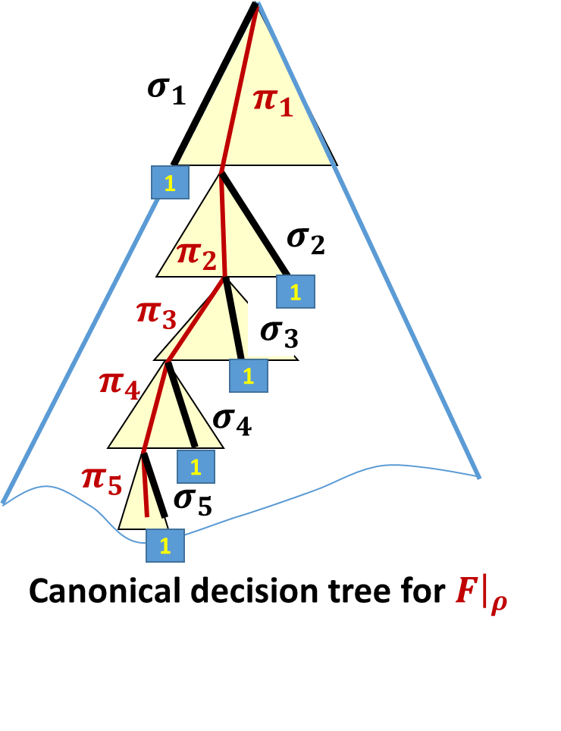
Switching Lemma Proof
Example
$F$
$${\overline{x}}_{2}{\overline{x}}_{3}x_{4}∨x_{2}x_{4}∨x_{1}{\overline{x}}_{2}x_{3}∨x_{1}x_{3}{\overline{x}}_{4}$$
Specify $ρ^{′}=ρσ_{1}…σ_{t}$
Specify where the $s$ vars set by $σ, π$ are in $T_{i_{1}}{,T}_{i_{2}}$,…, $T_{i_{t}}$
Specify values set by $π$
$ρ^{′}: x_{2}←1 ,x_{3}←1, { x}_{4} ←1, { x}_{1 }←1$
2;1
00
Claim: $F$plus 1, 2, & 3 let us reconstruct $ρ$
$T_{2}=$ 1st term not killed by $ρ^{1}=ρ′$. Note: $T_{2}{\left.​\right|}_{ρ^{1}}=1$
Define $ρ^{k}=ρπ_{1}…π_{k−1}σ_{k}…σ_{t}$
$ρ^{1}=ρ^{′}$
$T_{i_{k}}$is 1st term of $F$ surviving in $F{\left.​\right|}_{ρπ_{1}…π_{k−1}}$ and $T_{i_{k}}{\left.​\right|}_{ρ^{k}}=1$
Can build $ρ^{k+1}$ from $i_{k}$ and $F$ plus $ρ^{k}$, 2, & 3
2) + $T_{2}$ ⇒ $x_{4}$ was set by $σ,π$
3) ⇒ ${π_{1}: x}_{4}→0$
$$ρ^{2}: x_{2}←1 ,x_{3}←1, { x}_{4} ←0, { x}_{1 }←1$$
Once all $σ_{1}…σ_{t}$ are known they can be removed to get $ρ$ from $ρ′$
$T_{4}=$ 1st term not killed by $ρ^{2}$...

Slide 50
Switching Lemma Proof
Specify $ρ^{′}=ρσ_{1}…σ_{t}$
Specify where the $s$ vars set by $σ, π$ are in $T_{i_{1}}{,T}_{i_{2}}$,…, $T_{i_{t}}$
Specify values set by $π$
So: $F$plus 1, 2, & 3 let us reconstruct $ρ$
1. $ρ^{′}∈R_{n}^{ℓ−s}$ so $|R_{n}^{ℓ−s}|$ possibilities
Bit vector of length $s−1$ for partition of $[s]$ into $\left|σ_{1}\right|,\left|σ_{2}\right|,…,\left|σ_{t}\right|$ plus elt of ${[r]}^{s}$ to indicate positions of each var in its term. Total $2^{s−1}r^{s}$
Bit vector of length $s$. Total $2^{s}$
So: less than ${\left(4r\right)}^{s}|R_{n}^{ℓ−s}|$ of the $ρ$ have such a bad path

Slide 51
Switching Lemma Proof
So: $\underset{ρ∼R_{n}^{ℓ}}{Pr}\left[D\left(F{\left.​\right|}_{ρ}\right)≥s\right]≤\frac{{\left(4r\right)}^{s}\left|R_{n}^{ℓ−s}\right|}{\left|R_{n}^{ℓ}\right|}$
${=\left(4r\right)}^{s}\frac{\left(\begin{matrix}n \\ ℓ−s\end{matrix}\right)2^{n−ℓ+s}}{\left(\begin{matrix}n \\ ℓ\end{matrix}\right)2^{n−ℓ}}$
$={\left(8r\right)}^{s}\frac{ℓ⋯(ℓ−s+1)}{\left(n−ℓ+s\right)⋯(n−ℓ+1)}$
$$<{\left(8r\right)}^{s} {\left(\frac{p}{1−p}\right)}^{s}$$
since $ℓ=pn$

Slide 52
Beyond switching: Multi-switching
The switching lemma gives failure probability for a single formula
For multiple formulas we used a union bound to bound the overall failure probability.
Can do even better than this using a multi-switching lemma
Extra slides are included at the end to show how multi-switching works

Slide 53
AC⁰[$p$] circuit lower bounds

Slide 54
AC⁰[$p$] circuit lower bounds
Theorem (Razborov, Smolensky): For distinct primes $q$ and $p$, $⊕_{q} ∉$ AC⁰[$p$].
Corollary: Majority does not have polynomial size AC⁰[$p$] circuits for prime $p$.
Proof:
1. Approximate any small AC⁰[$p$] circuit by a low degree polynomial over $𝔽p$
2. Show that function in question doesn’t have such a good approximation
Notion of approximation: Fraction of inputs on which value is correct.
For 1, show that each gate operation can be replaced by an approximation that introduces at most a tiny error.
By 2, accumulated error must be large so circuit must have many gates.

Slide 55
AC⁰[$p$] circuit lower bounds
Approximate any small AC⁰[$p$] circuit by a low degree polynomial over $𝔽p$
WLOG the circuit only has unbounded fan-in $∨$ and $⊕_{p}$ gates (and constant 1)
$⊕_{p}$ gates:
$⊕_{p}\left(x_{1},…,x_{k}\right)=\left\{\begin{matrix}0 & x_{1}+…+x_{k}≡0 (mod p) \\ 1 & otherwise\end{matrix}\right.$
unbounded $∨$ gates: Exact would require degree = fan-in: $∨\left(x_{1},…,x_{k}\right)=1−\left(1−x_{1}\right)⋯\left(1−x_{k}\right)$
Can replace $∨\left(x_{1},…,x_{k}\right)$ by $\prod_{i=1}^{t}{{(\sum_{j=1}^{k}{r_{ij}{ x}_{j})}}^{p−1}}$ for some $r_{ij}∈\{0,1\}$ so error is only $p^{−t}$ (deg $t(p−1)$):
Idea: Always correct if $∨$ is 0. If $∨$ is 1, for random $r_{ij}$ probability $\sum_{j=1}^{k}{r_{ij}{ x}_{j}}=0$ is $1/p$. so probability of error over independent $r_{ij}$ is $p^{−t}$. Fix choices of $r_{ij}$ to get fewest errors.
Lemma: Every size $S$, depth $d$, AC⁰[$p$] circuit approximated with error ${Sp}^{−t}$ by degree ${\left(t\left(p−1\right)\right)}^{d}$ over $𝔽p$
Increase degree by $p−1$ factor, no error:
$$⊕_{p}\left(x_{1},…,x_{k}\right)={\left(x_{1}+…+x_{k}\right)}^{p−1} mod p$$

Slide 56
AC⁰[$p$] circuit lower bounds
2. Show that function in question doesn’t have such a good approximation
Example: $Parity∉$ AC⁰[$p$] for $p≠2$ requires degree $Ω(\sqrt{n})$
Idea: Change of basis from $\{0,1\}$to $\left\{+1,−1\right\}$
Conceptually of form $b ↦ { \left(−1\right)}^{b}$
Actually, an invertible linear transformation $b↦1−2b$ so degree preserved.
Under $\left\{+1,−1\right\}$ basis: $Parity\left(x_{1},…,x_{n}\right)=x_{1}⋯x_{n}$. Also $x_{i}^{2}=1$.
So for $S>n/2$ , we have $\prod_{i∈S}{x_{i}=Parity\left(x_{1},…,x_{n}\right)⋅\prod_{i∉S}{x_{i}}}$.
Then, if $Parity$ had a good approximation by a low-degree polynomial then every Boolean function could be well-approximated in degree $n/2+O(\sqrt{n})$.
Not possible using dimension arguments

Slide 57
Putting things together
Every size $S$, depth $d$, AC⁰[$p$] circuit approximated with error ${Sp}^{−t}$ by degree ${\left(t\left(p−1\right)\right)}^{d}$ over $𝔽p$
Degree $Ω\left(\sqrt{n}\right)$ required for constant error < 1
Suffices to choose $t$ to be ${o(n}^{1/2d}/(p−1))$ to get a contradiction for circuits of size $S≪p^{t}$

Slide 58
Multi-Switching Lemma

Slide 59
Hastad’s Switching Lemma for many formulas
Lemma (Håstad): Let $F$ be a $r$-DNF formula on ${\left\{0,1\right\}}^{n}$. For $ℓ=pn$ we have $\underset{ρ∼R_{n}^{ℓ}}{Pr}\left[D\left(F{\left.​\right|}_{ρ}\right)≥s\right]≤{\left(8pr\right)}^{s}$
To use it for $k$ different $r$-DNFs at once by setting $p=1/(16r)$ and $s=log⁡k+1$ to get failure probability at most $k{\left(8pr\right)}^{s}≤1/2$.
To get better failure probability need larger $s$.
Alternative: A multiswitching lemma.

Slide 60
The Multi-switching improvement
Multiswitching Lemma consequence: Let $F_{1},F_{2},…, F_{k}$ be $r$-DNF formulas on ${\left\{0,1\right\}}^{n}$. For $ℓ=pn$ and $s≥\log{k }$ there is a distribution on restrictions 𝒟 depending on $F_{1},F_{2},…, F_{k}$ such that:
$∀ρ∈\text{𝒟}\text{. }\text{|}\text{Vars}\text{(}ρ)|=ℓ$
$\underset{ρ∼\text{𝒟}}{Pr}\left[{∃i∈\left[k\right].D(F}_{i}{\left.​\right|}_{ρ}\right)≥s]≤k {(48pr)}^{ℓ}$.
Improves from $s$ to $ℓ$
Decouples failure probability and target decision tree height $s≤ℓ$ provided $s≥\log{k }$

Slide 61
Multiswitching Lemma
A single decision tree $T$ of height $t$ is a common $s$-partial decision tree for $r$-DNF formulas $F_{1},F_{2},…, F_{k}$iff for every branch $τ$ of $T$, for every $i∈\left[k\right]$, $D\left(F_{i}{\left.​\right|}_{τ}\right)<s.$
Define $P(F_{1},…,F_{k}, t,s)$ to be the property that no such tree exists.
Multiswitching Lemma [Håstad 2014*]: Let $F_{1},F_{2},…, F_{k}$ be $r$-DNF formulas on ${\left\{0,1\right\}}^{n}$. For $ℓ=pn,$ integer $t$, and $s≥\log{k }$ we have $\underset{ρ∼R_{n}^{ℓ}}{Pr}[{P(F}_{1}{\left.​\right|}_{ρ}, …, F_{k}{\left.​\right|}_{ρ},t,s)]≤k {(24pr)}^{t}$.
*related lemma shown in [Impagliazzo, Matthews, Paturi 2012]

Slide 62
Applying Multi-switching
Multiswitching Lemma (Håstad 2014): Let $F_{1},F_{2},…, F_{k}$ be $r$-DNF formulas on ${\left\{0,1\right\}}^{n}$. For $ℓ=pn,$ integer $t$, and $s≥\log{k }$ we have $\underset{ρ∼R_{n}^{ℓ}}{Pr}[{P(F}_{1}{\left.​\right|}_{ρ}, …, F_{k}{\left.​\right|}_{ρ},t,s)]≤k {(24pr)}^{t}$.
Corollary: Let $F_{1},F_{2},…, F_{k}$ be $r$-DNF formulas on ${\left\{0,1\right\}}^{n}$. For $ℓ=pn$ and $s≥\log{k }$ there is a distribution on restrictions 𝒟 depending on $F_{1},F_{2},…, F_{k}$ such that:
$∀ρ∈\text{𝒟}\text{. }\text{|}\text{Vars}\text{(}ρ)|=ℓ$
$\underset{ρ∼\text{𝒟}}{Pr}\left[{∃i∈\left[k\right].D(F}_{i}{\left.​\right|}_{ρ}\right)≥s]≤k {(48pr)}^{ℓ}$.
Proof: Apply the Multiswitching Lemma with $ℓ^{′}=2ℓ$ and $t=ℓ$. Let $T$ be the height $t$ decision tree guaranteed by ${P(F}_{1}{\left.​\right|}_{ρ}, …, F_{k}{\left.​\right|}_{ρ},t,s)$ being false. The distribution $\text{𝒟}$ chooses $ρ=ρ^{′}τ$ for a random $ρ′∼R_{n}^{ℓ^{′}}$ and any (e.g. random) branch $τ$ of $T$.

Slide 63
Proving the Multi-switching Lemma
The original proof used conditional probability using arbitrary downward-closed conditions and random restrictions with independent probabilities over the bits.
We give a bit simpler proof using similar ideas to the proof of the basic lemma. Suppose that ${P(F}_{1}{\left.​\right|}_{ρ}, …, F_{k}{\left.​\right|}_{ρ},t,s)$ holds.
We will give a specific construction for a decision tree $T$ and bound that probability that it fails to be a height-$t$ $s$-partial decision tree for $F_{1}{\left.​\right|}_{ρ}, …, F_{k}{\left.​\right|}_{ρ}$.

Slide 64
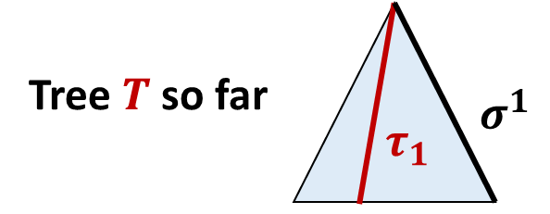
Multi-switching Lemma Proof
Given ${ρ,F}_{1}, …, F_{k}$let $j_{1}$ be the first index such that ${|D}_{T}\left(F_{j_{1}}{\left.​\right|}_{ρ}\right)|≥s$
Let $π^{1}$ be the lexicographically first path in the canonical decision tree for $F_{j_{1}}{\left.​\right|}_{ρ}$ of length $s$.
Define $σ^{1}=σ_{1}^{1}…σ_{u}^{1}$ as before, except make sure that $σ_{u}^{1}$ reaches the 1-leaf.
Then $s^{′}=\left|σ^{1}\right|≥s$ and $s^{′}<s+r$.
$π^{1}$ is enough to determine $σ^{1}$.
Begin building tree $T$ by with complete tree of height $s′$ on the variables set by $σ^{1}$
For every path $τ_{1}$ path of length $s’$ in $T$ continue as follows:

Slide 65
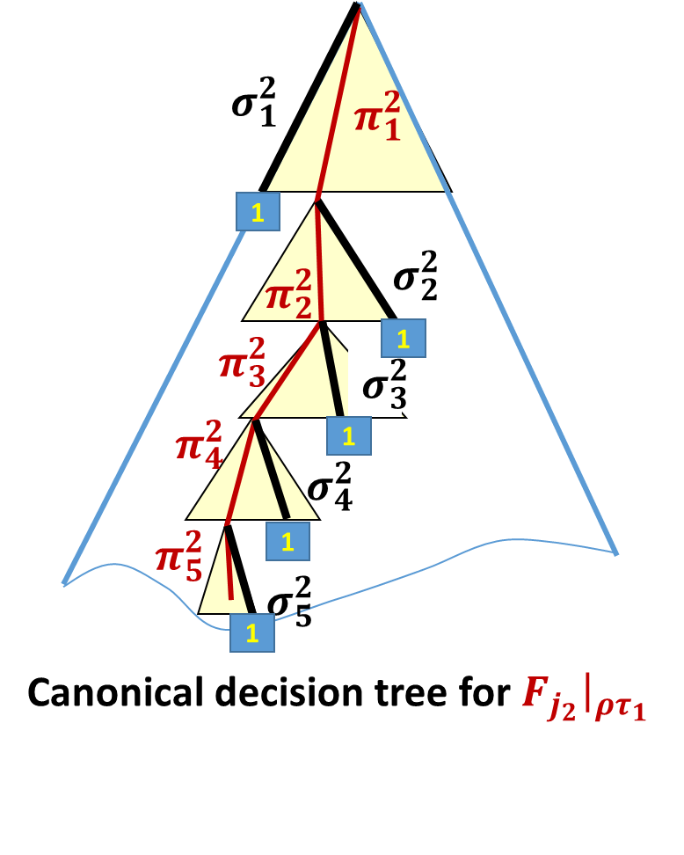
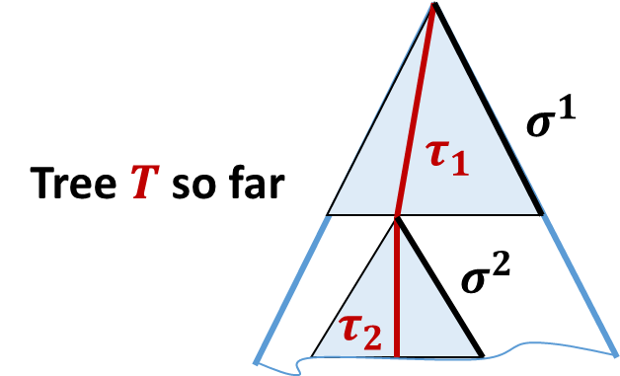
Multi-switching Lemma Proof
Given ${ρ,τ_{1},F}_{1}, …, F_{k}$let $j_{2}$ be the first index such that ${|D}_{T}\left(F_{j_{2}}{\left.​\right|}_{ρτ_{1}}\right)|≥s$
We have $j_{2}≥j_{1}$
Let $π^{2}$ be the lexicographically first path in the canonical decision tree for $F_{j_{2}}{\left.​\right|}_{ρτ_{1}}$ of length $s$.
Define $σ^{2}=σ_{1}^{2}…σ_{u^{′}}^{2}$ as before, except make sure that $σ_{u^{′}}^{2}$ reaches the 1-leaf.
Then $s^{′′}=\left|σ^{2}\right|≥s$ and $s^{′′}<s+r$.
$π^{2}$ is enough to determine $σ^{2}$.
Continue tree $T$ at leaf $τ_{1}$ with complete tree of height $s′′$ on the variables set by $σ^{2}$
For every path ${τ_{1}τ}_{2}$ in $T$ continue and repeat until no more indices.

Slide 66
Multi-switching Lemma Proof
Failure occurs iff there is a path of length $≥t$ in $T$
Let $τ$ be lex first such path
Let $σ^{1},…,σ^{v}$ correspond to $τ_{1},…,τ_{v}$.
Define $ρ^{′}=ρσ^{1}…σ^{v}∈R_{n}^{ℓ−t}$
As before we include info to decode $ρ$ from $ρ′$:
$j_{1},…,j_{v}$
$s$ vars within terms of $F_{j_{i}}$ set by $π^{i}$ for each $i∈[v]$
Bit vector of values set by $π^{1}…π^{v}$
Bit vector of values set by $τ_{1}…τ_{v}$
$$τ_{1}$$
$$σ^{1}$$
$$τ_{2}$$
$$σ^{2}$$
$$τ_{3}$$
$$σ^{3}$$
$$τ_{4}$$
$$σ^{4}$$
$$τ_{5}$$
$$σ^{5}$$
Tree $T$

Slide 67
Multi-switching Lemma Proof
Define $ρ^{′}=ρσ^{1}…σ^{v}∈R_{n}^{ℓ−t}$ . Info to decode $ρ$ from $ρ′$:
$j_{1},…,j_{v}∈[k]$
$s$ vars within terms of $F_{j_{i}}$ set by $π^{i}$ for each $i∈[v]$
Bit vector of values set by $π^{1}…π^{v}$
Bit vector of values set by $τ_{1}…τ_{v}$
Claim: this is enough to decode given $F_{1},…,F_{k},s,t$:
Look at first term $T_{i_{1}}$ set to 1 in $F_{j_{1}}{\left.​\right|}_{ρ^{′}}$ (previous terms will be set to 0). This yields $σ_{1}^{1}$. Use the information from 2 to determine which vars of $T_{i_{1}}$are unset by $ρ$ and hence set by $π_{1}^{1}$.
Use 3 to determine $π_{1}^{1}$.
Continue as in the ordinary switching lemma decoding by replacing $σ_{1}^{1}$ by $π_{1}^{1}$ in $ρ^{′}$ to get $ρ^{′′}.$ Then look at 1st term $T_{i_{2}}$ set to 1 in $F_{j_{1}}{\left.​\right|}_{ρ^{′′}}$ etc. Continue replacing until get all of $σ^{1}$.
Now go back and replace $σ^{1}$ by $τ_{1}$ in $ρ′$ to get $ρτ_{1}σ^{2}…σ^{v}$, using 4.

Slide 68
Multi-switching Lemma Proof
Define $ρ^{′}=ρσ^{1}…σ^{v}∈R_{n}^{ℓ−t}$ . Info to decode $ρ$ from $ρ′$:
$j_{1},…,j_{v}∈[k]$
$s$ vars within terms of $F_{j_{i}}$ set by $π^{i}$ for each $i∈[v]$
Bit vector of values set by $π^{1}…π^{v}$
Bit vector of values set by $τ_{1}…τ_{v}$
Counts:
$k^{v}≤2^{\left(v−1\right)s}k≤k⋅2^{t}$ since $s≥\log{k}$ and $s\left(v−1\right)≤t$
$2^{t^{′}−1}r^{t^{′}}$ where $t^{′}≤t$ is the total length of $π^{1}…π^{v}$
Total $≤2^{t}r^{t}$
$2^{t^{′}}$
$2^{t}$
Total fraction of restrictions where $P(F_{1},…,F_{k}, t,s)$ holds is at most: ${{\left(16r\right)}^{t}{{|R}_{n}^{ℓ−t}|}/{\left|R_{n}^{ℓ}\right|}=k \left(16r\right)}^{t}\frac{\left(\begin{matrix}n \\ ℓ−t\end{matrix}\right)2^{n−ℓ+t}}{\left(\begin{matrix}n \\ ℓ\end{matrix}\right)2^{n−ℓ}}$
$={k \left(32r\right)}^{t}\frac{ℓ…(ℓ−t+1)}{\left(n−ℓ+t\right)…(n−ℓ+1)}≤k{\left(\frac{32pr}{1−p}\right)}^{t}$

